Slide 1
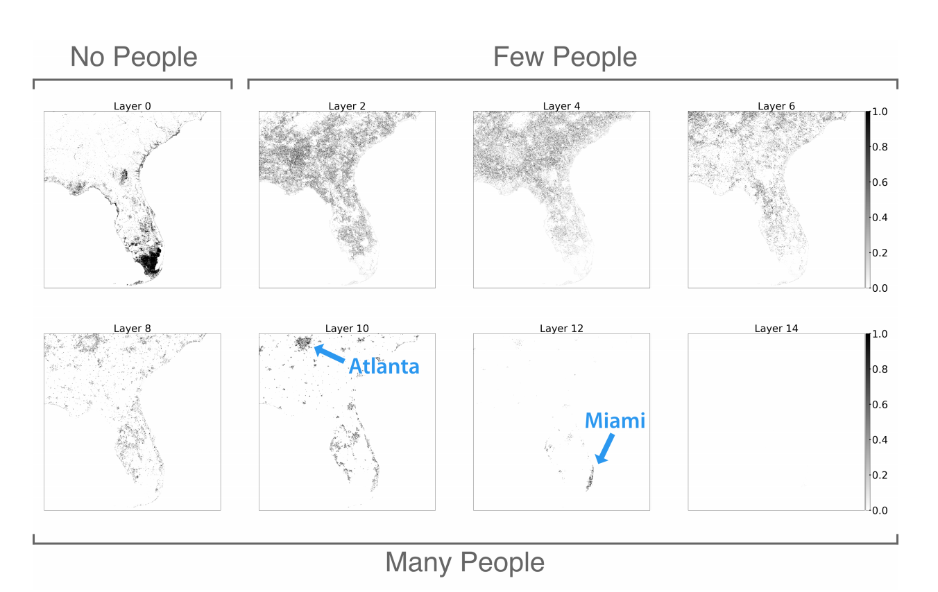
STAT 157 - Project #18
ACID: Analyzing Census and Imaging Data
Alex Kassil, Catherine Cang, Inna Chernomorets, Derek Topper
March 5, 2019
Using Convolutional LSTM networks to monitor and forecast populations of countries based on satellite images gathered around the globe while designing our own architecture, using imagery from countries across the globe, and comparing Convolutional LSTM to other networks.
Notes:
Hi! This is our presentation ACID, we are ...
General idea: We want to use newer deep learning models and higher quality satellite image data to improve population prediction and forecasting in various regions around the world

Slide 2
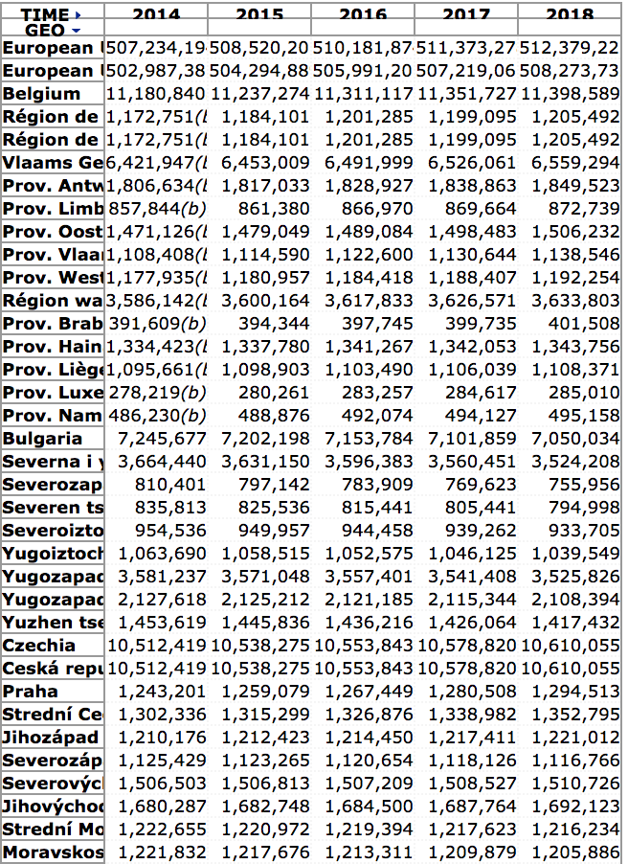
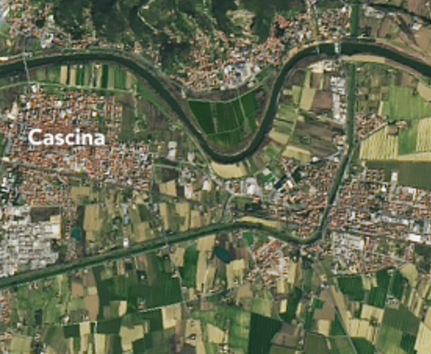
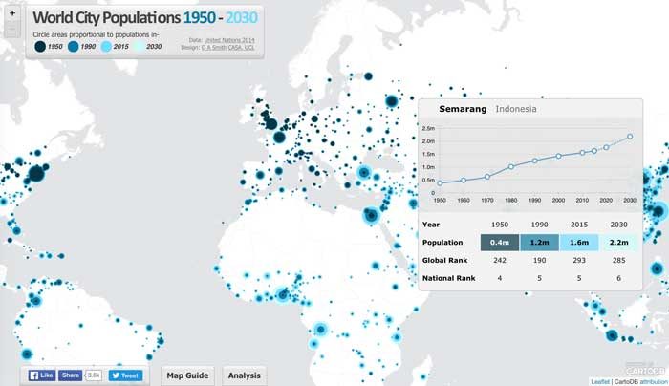
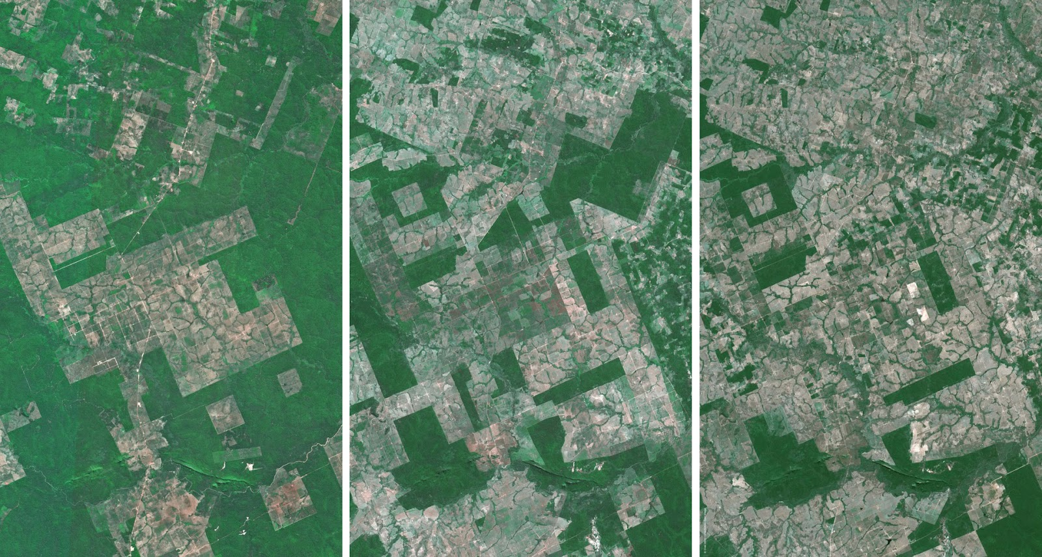
Problem Statement
Goal: To automatically monitor and forecast population trends in areas given satellite images
Status quo: Not enough manual resources, especially within developing governments, for frequent updates on population
Satellite images from various sites
Solution: Deep learning and satellite images!
Example of Landsat 7 data (Cascina, Italy)
Notes:
Read slides
Examples: US Census done only once every 10 years
Most countries use forecasting equations that are not necessarily accurate
Click
Near-daily Images in many regions are available due to improved satellite technology
This data allows for plenty of training data for making our model on predicting population, and in the future, allows for more frequent monitoring of populations
**Click**
Left: Landsat images, Middle: Various satellite images (LandSAT, Planet, GLAD)
These vary in quality
Our model requires 2 main data sources: Satellite images, and population data
We plan to use open-source satellite imaging from mainly Landsat 7, which provide up-to-date and cloud-free images of the earth, and join it with population data from Eurostat, which provides census data from the European Union over many years

Slide 3
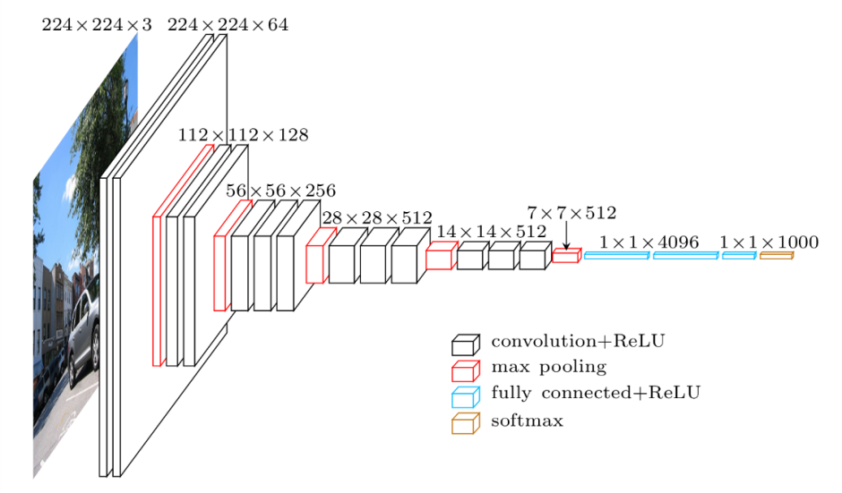
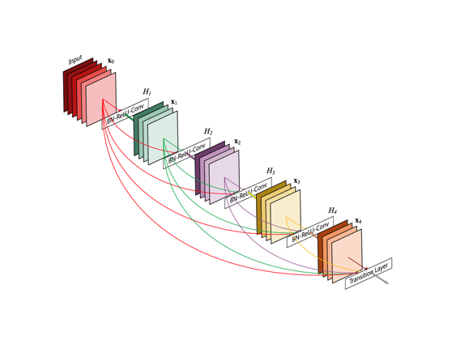
Methods
Predicting Current Population
VGGNet, ResNet, and DenseNet convolutional neural network models
2. Forecasting Future Population Growth
Convolutional LSTMs
Predicting population of each of the 5 years of images passed in and using a normal time-series or LSTM model to predict the next population given the past 5 years.
Notes:
Past research has been done using American and Ugandan population predictions
We want to improve this research with a few modifications
First, we use increased number of past data generated from our satellite to population model for forecasting future populations
In the past, most models have been on classification. We plan on expanding to regression
Only US + Uganda done
VGGNet pictured on left, DenseNet on right
Click
This task is the more difficult one, since it hasn’t been done before. We have two main approaches
1. We use convolution LSTMs, passing in the past few years of satellite images and making our last layer into a single-value cell that predicts the next population
2. We pass in the past few years of satellite images again into our model from the previous task, and use those predicted population numbers in a time-series or LSTM model to predict the next population number

